Slide 1
Carmel Green Teen Micro-Grant Program
carmelgreenteen.org

Slide 2
Basics
Fund youth-planned, youth-led environmental projects in Carmel
Up to $1000 available per project
School clubs, scout groups, religious groups, community groups, or groups of friends welcome to apply
Over twenty projects funded since 2009
About $7000 to give away this grant cycle!
carmelgreenteen.org

Slide 3
To qualify for funding, project must:
Save energy, reduce pollution, and/or conserve resources
Be planned and implemented by youth (high school or younger)
Take place in Carmel
Have a realistic budget
Have an educational component
Have obtained necessary permission
Be completed within 9 months of award date
carmelgreenteen.org

Slide 4
The Best Projects …
Involve a large number of young people
Make a LASTING difference in the community
Educate many people
Have highly motivated, passionate youth leaders who are excited about carrying out the project and helping the environment
carmelgreenteen.org

Slide 5
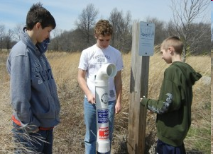
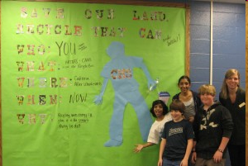
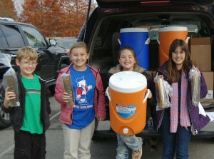
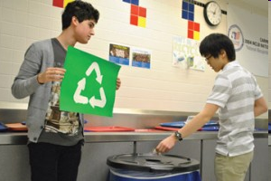
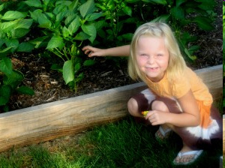
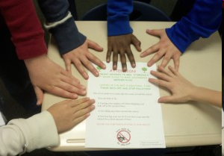
Carmel Green Teen Funded Projects
Fishing Line Recycling Program
St. Elizabeth Ann Seton Catholic Church
Mission Recycle
Carmel Middle School
Taming the Beast: Recycling at CHS
Carmel High School
Coolers are Cooler with Cups
Cherry Tree Elementary
Mosaics Family Garden
Mosaics School
Reduce, Reuse, Recycle
Woodbrook Elementary

Slide 6
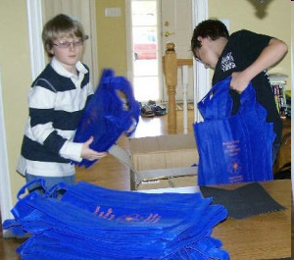
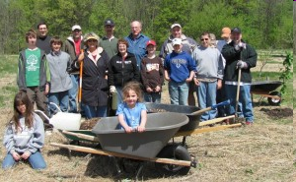
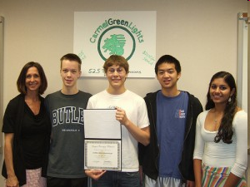
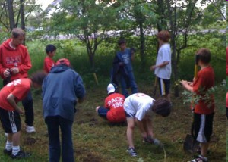
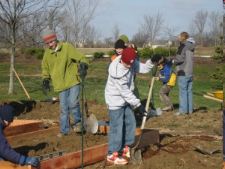
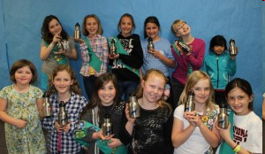
Carmel Green Teen Funded Projects
Scouts Reusable Bag Project
Prairie Trace Elementary
West Park Tree Scouts
Golden K Kiwanis
Boy Scouts
Wildflower Reintroduction at White River
Woodbrook Elementary
Green Lights Club
Carmel High School
Organic Garden Ministry for Food Pantries
St. Christopher’s Episcopal Church
Ban the Bottle, Try the Tap
Towne Meadow Elementary

Slide 7
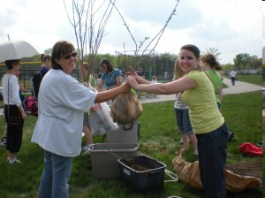
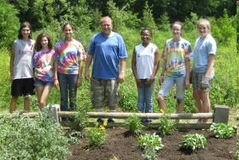
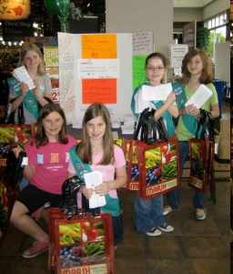
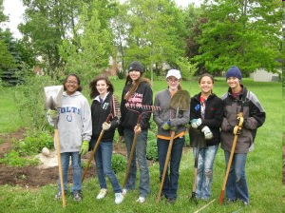
Carmel Green Teen Funded Projects
Flutter Flowers Butterfly Reintroduction Clay Middle School Ecolab
Girl Scouts of Central Indiana
Arbor Day Tree Seedling Give-Away
Carmel Middle School
Flutter Flowers Butterfly Reintroduction Carey Grove Park
Girl Scouts of Central Indiana
A Greener Future is in the Bag
Girl Scouts of Central Indiana

Slide 8
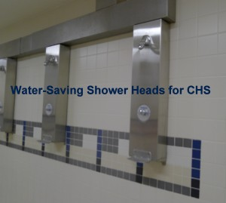
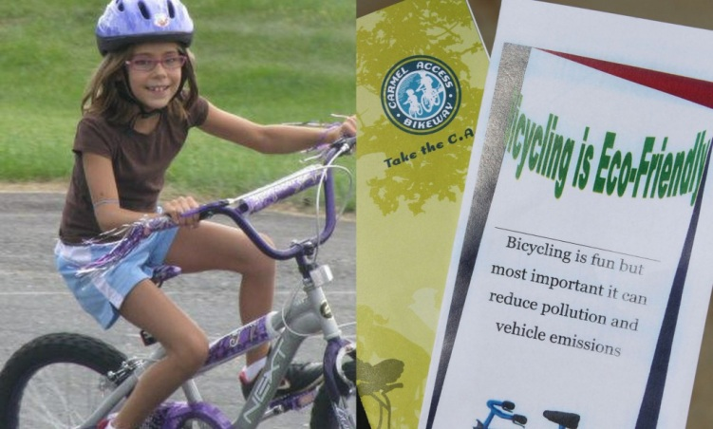
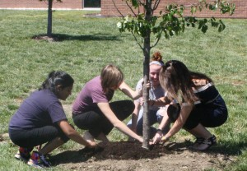
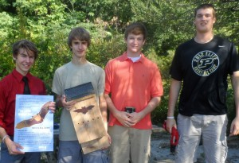
Carmel Green Teen Funded Projects
Green Showers
Carmel High School
Bikeyard 100
Creekside Middle School
Girl Scouts of Central Indiana
Tree Hugging Trailblazers
UHS Green Club
Bats: Nature’s Bug Zappers
St. Elizabeth Ann Seton Catholic Church
Boy Scouts

Slide 9
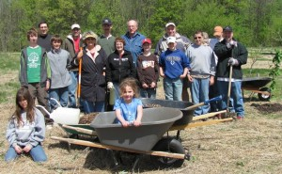
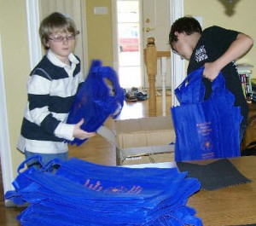
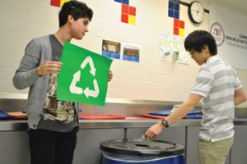
Project Ideas
Educational campaigns (what can be recycled?)
Waste-free lunch initiatives
Promoting alternatives to bottled water
Planting trees
carmelgreenteen.org

Slide 10
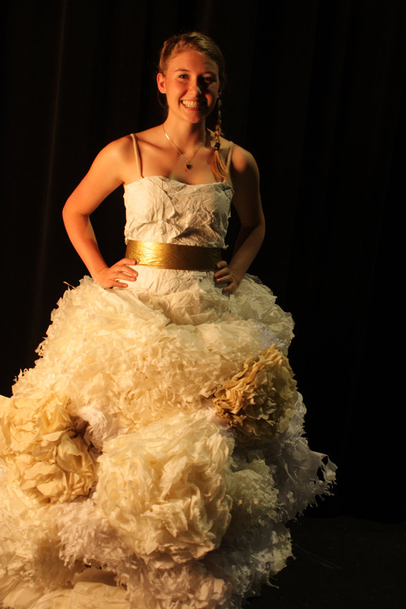
More Project Ideas
Recycling program (or improvement)
Roadside/Waterway cleanup
Compost bin or rain barrel workshops
Trashion show
Recycled art
carmelgreenteen.org

Slide 11
How to apply for a grant:
Double check criteria at carmelgreenteen.org
Email info@carmelgreenteen.org with questions
Visit carmelgreenteen.org to download application
Final page of application is a permission form for all projects taking place in Carmel schools. This needs to be filled out by February 18!
Fill out application, including all signatures and permission forms, to be submitted by February 28
carmelgreenteen.org

Slide 12
Important dates for grants:
CCS permission form due: February 18
Full application due: February 28
Short interview session: early- to mid-March
Grant award ceremony: late March
carmelgreenteen.org

Slide 13
“Each and every one of us can make changes in the way we live our lives and become part of the solution.”
-Al Gore
carmelgreenteen.org

